Slide 1
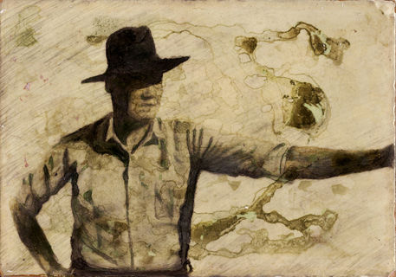
“Abuelito Who”
Sandra Cisneros

Slide 2
Grade 6 TEKS
(4) Reading/Comprehension of Literary Text/Poetry.
Students understand, make inferences and draw conclusions about the structure and elements of poetry and provide evidence from text to support their understanding. Students are expected to explain how figurative language (e.g., personification, metaphors, similes, hyperbole) contributes to the meaning of a poem.
(15) Writing/Literary Texts.
Students write literary texts to express their ideas and feelings about real or imagined people, events, and ideas. Students are expected to:
(B) write poems using:
(i) poetic techniques (e.g., alliteration, onomatopoeia);
(ii) figurative language (e.g., similes, metaphors); and
(iii) graphic elements (e.g., capital letters, line length).

Slide 3
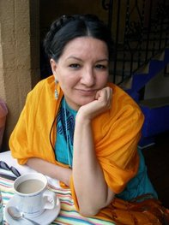
Who is Sandra Cisneros?
American writer and poet.
Born on December 20, 1954, in Chicago, Illinois.
One of seven children and the only daughter
She and her six brothers grew up in Mexico and Chicago.
Constant moving often made her feel displaced and divided her cultural loyalties.
She has written extensively about the Latina experience in the United States.
Cisneros is best known for The House on Mango Street (1984), which tells the story of a young Latina woman coming of age in Chicago.
The novel has sold more than two million copies.

Slide 4
Benefits of Using a Lap Book
Encourages students to find the information they are looking for.
Allows teachers and to students observe and evaluate level of understanding.
Can be adjusted to meet the needs of any student (LD or GT).
Allows students to learn variety of skills.
Breaks down large or difficult content into manageable parts.
Enables students to interactively review material.
Tool for displaying classroom knowledge.

Slide 5
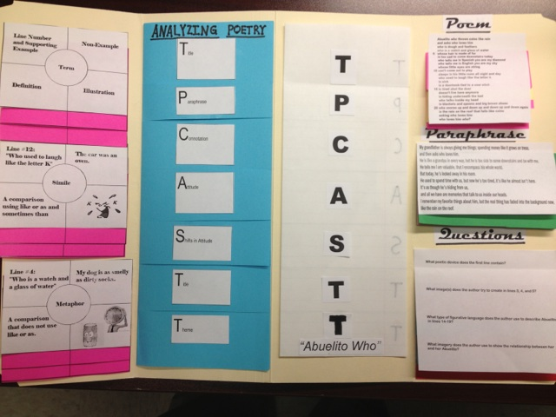
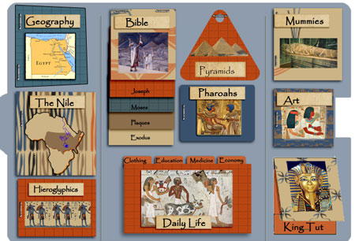
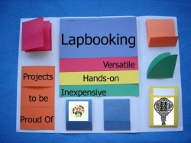
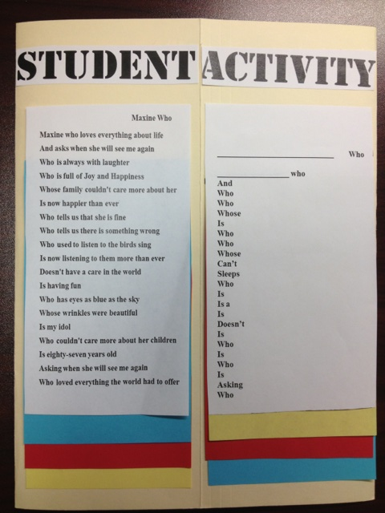
Lap Book Examples (Oct. 15th)

Slide 6
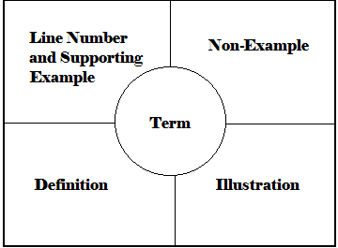
Vocabulary Preview
Pre-teach vocabulary
or poetic devices
Should be defined as well as
discussed
This allows students to develop
an understanding of the word’s
connotations as well as its
denotation.
Provides teachers with feedback
Choice Board

Slide 7
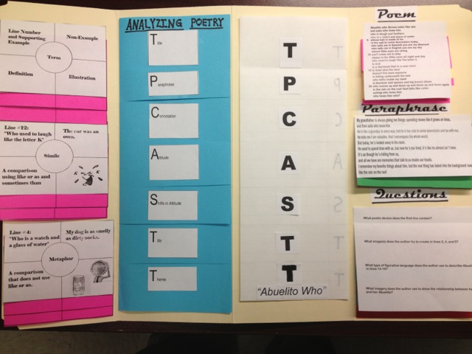
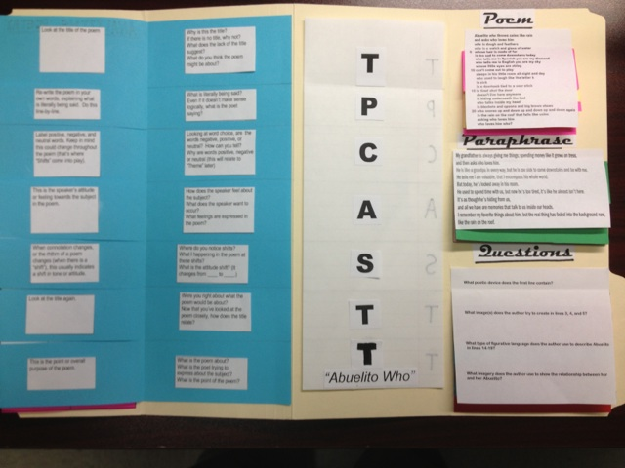
Analyzing the Poem : TPCASTT
Title
Paraphrase
Connotation
Attitude
Shifts
Title
Theme

Slide 8
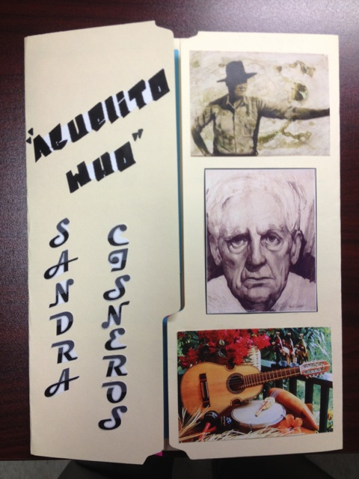
Title: “Abuelito Who”
What do you think
about when you
read the title?

Slide 9
HIDDEN STEP:
Before you move to the next step, now is the time to READ THE POEM! This is the most important part of the process.

Slide 10
“Abuelito Who” by Sandra Cisneros
Abuelito who throws coins like rain
and asks who loves him
who is dough and feathers
who is a watch and glass of water
5 whose hair is made of fur
is too sad to come downstairs today
who tells me in Spanish you are my diamond
who tells me in English you are my sky
whose little eyes are string
10 can’t come out to play
sleeps in his little room all night and day
who used to laugh like the letter k
is sick
is a doorknob tied to a sour stick
15 is tired shut the door
doesn’t live here anymore
is hiding underneath the bed
who talks inside my head
is blankets and spoons and big brown shoes
20 who snores up and down up and down up and down again
is the rain on the roof that falls like coins
asking who loves him
who loves him who?

Slide 11
Paraphrase:
Rewrite the poem in your own words. (line by line or by stanzas)
Tell what happens, not what it means.

Slide 12
Connotation:
Circle the words with
strong associations or feelings.
Can put a plus or minus sign next to the word to identify positive and negative feelings.
Identify the figurative language and sound devices used.

Slide 13
Questions:
What poetic device does the first
line contain?
What image(s) does the author try to create in lines 3, 4, and 5?
What is happening in line 6? Does the speaker understand?
Why can’t Abuelito “come out to play”?
What can we infer has happened by line 13?
What type of figurative language does the author use to describe
Abuelito in lines 14-19?
Compare line 21 to line 1? What differences do you see?
What imagery does the author use to show the relationship between
her and her Abuelito?

Slide 14
ATTITUDE / SHIFT
This is the tone of the speaker.
What does the speaker of the poem (not the poet) feel about the
subject or characters in the poem?
Angry Ironic
Humorous Sad
Serious
Use the positive and negative tone/mood word list
Where and why does the attitude change, if it does?
Help students identify changes (Tone, Key Words,
Punctuation, Line Length, Subject, etc.)

Slide 15
Title
Re-examine the title.
How has your understanding
of the title changed
since before analyzing the poem?

Slide 16
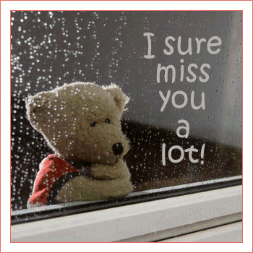
Theme
Put it all together, what have you learned?
What is the message you can take from the story?
(Lesson Learned)
What words does the author use to convey
this message?
Ask specific questions to help students reflect.
“Refer back to the subjects in number 19.
What does the author say about these?”

Slide 17
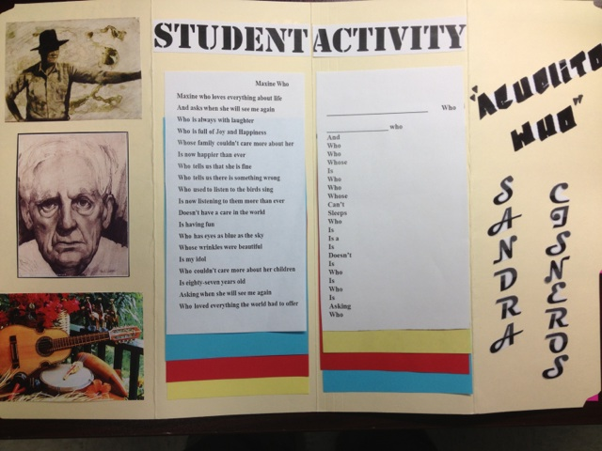
Activity
The students will recreate their own version of the poem
The students should choose someone who they care about deeply.
Students should brainstorm a list of personality characteristics,
interests, physical features, and phrases that are unique to their
chosen person.
Students should use the “Abuelito Who” template to aid their
writing of their poem.
Students then plug their own original ideas into the structure and
create the rest of the line.

Slide 18
Student Activity
Maxine Who
Maxine who loves everything about life
And asks when she will see me again
Who is always with laughter
Who is full of Joy and Happiness
Whose family couldn't care more about her
Is now happier than ever
Who tells us that she is fine
Who tells us there is something wrong
Who used to listen to the birds sing
Is now listening to them more than ever
Doesn't have a care in the world
Is having fun
Who has eyes as blue as the sky
Whose wrinkles were beautiful
Is my idol
Who couldn't care more about her children
Is eighty-seven years old
Asking when she will see me again
Who loved everything the world had to offer
____________________________ Who
_________________ who
And
Who
Who
Whose
Is
Who
Who
Whose
Can’t
Sleeps
Who
Is
Is a
Is
Doesn’t
Is
Who
Is
Who
Is
Asking
Who
By_______________________________________________

